Slide 2
Sequential Circuits
Asynchronous
Synchronous
Combinational
Circuit
Inputs
Outputs
Memory Elements
Combinational
Circuit
Inputs
Outputs
Flip-flops
Clock

Slide 3
Latches
SR Latch
S R Q₀ | Q | Q’
0 0 0
0 | 1
Q = Q₀
0
0
0
1
Initial Value

Slide 4
Latches
SR Latch
S R Q₀ | Q | Q’
0 0 0 | 0 | 1
0 0 1
Q = Q₀
1 | 0
Q = Q₀
0
1
0
0

Slide 5
Latches
SR Latch
S R Q₀ | Q | Q’
0 0 0 | 0 | 1
0 0 1 | 1 | 0
0 1 0 | 0
Q = Q₀
1
 | 1
Q = 0
0
0
1

Slide 6
Latches
SR Latch
S R Q₀ | Q | Q’
0 0 0 | 0 | 1
0 0 1 | 1 | 0
0 1 0 | 0 | 1
0 1 1
Q = Q₀
1
Q = 0
1
0 | 1
Q = 0
0
0

Slide 7
Latches
SR Latch
S R Q₀ | Q | Q’
0 0 0 | 0 | 1
0 0 1 | 1 | 0
0 1 0 | 0 | 1
0 1 1 | 0 | 1
1 0 0
Q = Q₀
0
0
Q = 0
1 | 0
Q = 1
1
1

Slide 8
Latches
SR Latch
S R Q₀ | Q | Q’
0 0 0 | 0 | 1
0 0 1 | 1 | 0
0 1 0 | 0 | 1
0 1 1 | 0 | 1
1 0 0 | 1 | 0
1 0 1
Q = Q₀
0
1
Q = 0
Q = 1
1 | 0
Q = 1
1
0

Slide 9
Latches
SR Latch
S R Q₀ | Q | Q’
0 0 0 | 0 | 1
0 0 1 | 1 | 0
0 1 0 | 0 | 1
0 1 1 | 0 | 1
1 0 0 | 1 | 0
1 0 1 | 1 | 0
1 1 0
Q = Q₀
1
0
Q = 0
Q = 1
0 | 0
Q = Q’
1
1
0

Slide 10
Latches
SR Latch
S R Q₀ | Q | Q’
0 0 0 | 0 | 1
0 0 1 | 1 | 0
0 1 0 | 0 | 1
0 1 1 | 0 | 1
1 0 0 | 1 | 0
1 0 1 | 1 | 0
1 1 0 | 0 | 0
1 1 1
Q = Q₀
1
1
Q = 0
0
Q = 1
Q = Q’
0 | 0
Q = Q’
1
0

Slide 11
Latches
SR Latch
S R | Q
0 0 | Q₀
0 1 | 0
1 0 | 1
1 1 | Q=Q’=0
No change
Reset
Set
Invalid
S R | Q
0 0 | Q=Q’=1
0 1 | 1
1 0 | 0
1 1 | Q₀
Invalid
Set
Reset
No change

Slide 12
Latches
SR Latch
S R | Q
0 0 | Q₀
0 1 | 0
1 0 | 1
1 1 | Q=Q’=0
No change
Reset
Set
Invalid
S’ R’ | Q
0 0 | Q=Q’=1
0 1 | 1
1 0 | 0
1 1 | Q₀
Invalid
Set
Reset
No change

Slide 13
Controlled Latches
SR Latch with Control Input
C S R | Q
0 x x | Q₀
1 0 0 | Q₀
1 0 1 | 0
1 1 0 | 1
1 1 1 | Q=Q’
No change
No change
Reset
Set
Invalid

Slide 14
Controlled Latches
D Latch (D = Data)
Timing Diagram
C
D
Q
t
C D | Q
0 x | Q₀
1 0 | 0
1 1 | 1
Output may change
No change
Reset
Set

Slide 15
Controlled Latches
D Latch (D = Data)
Timing Diagram
C
D
Q
C D | Q
0 x | Q₀
1 0 | 0
1 1 | 1
Output may change
No change
Reset
Set

Slide 16
Flip-Flops
Controlled latches are level-triggered
Flip-Flops are edge-triggered
C
CLK
Positive Edge
CLK
Negative Edge

Slide 17
Flip-Flops
Master-Slave D Flip-Flop
D Latch
(Master)
D Latch
(Slave)
D
D
C
Q
D
C
Q
Q
Master
Slave
CLK
CLK
D
Looks like it is negative edge-triggered
Q_{Master}
Q_{Slave}

Slide 18
Flip-Flops
★ Edge-Triggered D Flip-Flop
D Q
Q
Q
Positive
Edge
CLK
D Q
Q
Q
D
Negative
Edge

Slide 19
Flip-Flops
JK Flip-Flop
J
Q
D = JQ’ + K’Q
K
Q

Slide 20
Flip-Flops
T Flip-Flop
T
J
Q
T
D
Q
Q
K
Q
T
Q
D = JQ’ + K’Q
D = TQ’ + T’Q = T ⊕ Q
Q

Slide 21
Flip-Flop Characteristic Tables
D | Q(t+1)
0 | 0
1 | 1
D
Q
Reset
Set
Q
J | K | Q(t+1)
0 | 0 | Q(t)
0 | 1 | 0
1 | 0 | 1
1 | 1 | Q’(t)
J
Q
No change
Reset
Set
Toggle
K
Q
T
Q
T | Q(t+1)
0 | Q(t)
1 | Q’(t)
No change
Toggle
Q

Slide 22
Flip-Flop Characteristic Equations
D | Q(t+1)
0 | 0
1 | 1
D
Q
Q(t+1) = D
Q
J | K | Q(t+1)
0 | 0 | Q(t)
0 | 1 | 0
1 | 0 | 1
1 | 1 | Q’(t)
J
Q
Q(t+1) = JQ’ + K’Q
K
Q
T
Q
T | Q(t+1)
0 | Q(t)
1 | Q’(t)
Q(t+1) = T ⊕ Q
Q

Slide 23
Flip-Flop Characteristic Equations
Analysis / Derivation
J | K | Q(t) | Q(t+1)
0 | 0 | 0 | 0
0 | 0 | 1 | 1
0 | 1 | 0
0 | 1 | 1
1 | 0 | 0
1 | 0 | 1
1 | 1 | 0
1 | 1 | 1
No change
Reset
Set
Toggle
J
Q
K
Q

Slide 24
Flip-Flop Characteristic Equations
Analysis / Derivation
J | K | Q(t) | Q(t+1)
0 | 0 | 0 | 0
0 | 0 | 1 | 1
0 | 1 | 0 | 0
0 | 1 | 1 | 0
1 | 0 | 0
1 | 0 | 1
1 | 1 | 0
1 | 1 | 1
No change
Reset
Set
Toggle
J
Q
K
Q

Slide 25
Flip-Flop Characteristic Equations
Analysis / Derivation
J | K | Q(t) | Q(t+1)
0 | 0 | 0 | 0
0 | 0 | 1 | 1
0 | 1 | 0 | 0
0 | 1 | 1 | 0
1 | 0 | 0 | 1
1 | 0 | 1 | 1
1 | 1 | 0
1 | 1 | 1
No change
Reset
Set
Toggle
J
Q
K
Q

Slide 26
Flip-Flop Characteristic Equations
Analysis / Derivation
J | K | Q(t) | Q(t+1)
0 | 0 | 0 | 0
0 | 0 | 1 | 1
0 | 1 | 0 | 0
0 | 1 | 1 | 0
1 | 0 | 0 | 1
1 | 0 | 1 | 1
1 | 1 | 0 | 1
1 | 1 | 1 | 0
No change
Reset
Set
Toggle
J
Q
K
Q

Slide 27
Flip-Flop Characteristic Equations
Analysis / Derivation
J | K | Q(t) | Q(t+1)
0 | 0 | 0 | 0
0 | 0 | 1 | 1
0 | 1 | 0 | 0
0 | 1 | 1 | 0
1 | 0 | 0 | 1
1 | 0 | 1 | 1
1 | 1 | 0 | 1
1 | 1 | 1 | 0
J
Q
 |  |  |  | K
 |  | 0 | 1 | 0 | 0
J |  | 1 | 1 | 0 | 1
 |  |  | Q
K
Q
Q(t+1) = JQ’ + K’Q

Slide 28
Analysis of Clocked Sequential Circuits
The State
State = Values of all Flip-Flops
Example
A B = 0 0

Slide 29
Analysis of Clocked Sequential Circuits
State Equations
A(t+1) = D_{A}
= A(t) x(t)+B(t) x(t)
= A x + B x
B(t+1) = D_{B}
= A’(t) x(t)
= A’ x
y(t) = [A(t)+ B(t)] x’(t)
= (A + B) x’

Slide 30
Analysis of Clocked Sequential Circuits
State Table (Transition Table)
Present State |  | Input | Next State |  | Output
A | B | x | A | B | y
0 | 0 | 0
0 | 0 | 1
0 | 1 | 0
0 | 1 | 1
1 | 0 | 0
1 | 0 | 1
1 | 1 | 0
1 | 1 | 1
0 0 0
0 1 0
0 0 1
1 1 0
0 0 1
1 0 0
0 0 1
1 0 0
A(t+1) = A x + B x
B(t+1) = A’ x
y(t) = (A + B) x’
t
t+1
t

Slide 31
Analysis of Clocked Sequential Circuits
State Table (Transition Table)
Present State |  |  | Next State |  |  |  | Output
 |  |  | x = 0 |  | x = 1 |  | x = 0 | x = 1
A |  | B | A | B | A | B | y | y
0 |  | 0 | 0 | 0 | 0 | 1 | 0 | 0
0 |  | 1 | 0 | 0 | 1 | 1 | 1 | 0
1 |  | 0 | 0 | 0 | 1 | 0 | 1 | 0
1 |  | 1 | 0 | 0 | 1 | 0 | 1 | 0
t
t+1
t
A(t+1) = A x + B x
B(t+1) = A’ x
y(t) = (A + B) x’

Slide 32
Analysis of Clocked Sequential Circuits
State Diagram
Present State |  |  | Next State |  |  |  | Output
 |  |  | x = 0 |  | x = 1 |  | x = 0 | x = 1
A |  | B | A | B | A | B | y | y
0 |  | 0 | 0 | 0 | 0 | 1 | 0 | 0
0 |  | 1 | 0 | 0 | 1 | 1 | 1 | 0
1 |  | 0 | 0 | 0 | 1 | 0 | 1 | 0
1 |  | 1 | 0 | 0 | 1 | 0 | 1 | 0
AB
input/output
0/0
1/0
0/1
0 0
1 0
0/1
1/0
0/1
1/0
0 1
1 1
1/0

Slide 33
Analysis of Clocked Sequential Circuits
D Flip-Flops
Example:
x
D
Q
A
y
Present State | Input |  | Next State
A | x | y | A
0 | 0 | 0
0 | 0 | 1
0 | 1 | 0
0 | 1 | 1
1 | 0 | 0
1 | 0 | 1
1 | 1 | 0
1 | 1 | 1
CLK
Q
0
1
1
0
1
0
0
1
A(t+1) = D_{A} = A ⊕ x ⊕ y
01,10
0
1
00,11
00,11
01,10

Slide 34
Analysis of Clocked Sequential Circuits
JK Flip-Flops
Example:
Present State |  | I/P | Next State |  | Flip-Flop Inputs
A | B | x | A | B | J_{A} | K_{A} | J_{B} | K_{B}
0 | 0 | 0
0 | 0 | 1
0 | 1 | 0
0 | 1 | 1
1 | 0 | 0
1 | 0 | 1
1 | 1 | 0
1 | 1 | 1
0 1
0 0
1 1
1 0
1 1
1 0
0 0
1 1
0 0 1 0
0 0 0 1
1 1 1 0
1 0 0 1
0 0 1 1
0 0 0 0
1 1 1 1
1 0 0 0
J_{A} = B K_{A} = B x’
J_{B} = x’ K_{B} = A ⊕ x
A(t+1) = J_{A} Q’_{A} + K’_{A} Q_{A}
= A’B + AB’ + Ax
B(t+1) = J_{B} Q’_{B} + K’_{B} Q_{B}
= B’x’ + ABx + A’Bx’

Slide 35
Analysis of Clocked Sequential Circuits
JK Flip-Flops
Example:
Present State |  | I/P | Next State |  | Flip-Flop Inputs
A | B | x | A | B | J_{A} | K_{A} | J_{B} | K_{B}
0 | 0 | 0
0 | 0 | 1
0 | 1 | 0
0 | 1 | 1
1 | 0 | 0
1 | 0 | 1
1 | 1 | 0
1 | 1 | 1
0 1
0 0
1 1
1 0
1 1
1 0
0 0
1 1
0 0 1 0
0 0 0 1
1 1 1 0
1 0 0 1
0 0 1 1
0 0 0 0
1 1 1 1
1 0 0 0
1
0
1
0 0
1 1
0
0
0
0 1
1 0
1
1

Slide 36
Analysis of Clocked Sequential Circuits
T Flip-Flops
Example:
Present State |  | I/P | Next State |  | F.F Inputs |  | O/P
A | B | x | A | B | T_{A} | T_{B} | y
0 | 0 | 0
0 | 0 | 1
0 | 1 | 0
0 | 1 | 1
1 | 0 | 0
1 | 0 | 1
1 | 1 | 0
1 | 1 | 1
0 0
0 1
0 1
1 0
1 0
1 1
1 1
0 0
0 0
0 1
0 0
1 1
0 0
0 1
0 0
1 1
0
0
0
0
0
0
1
1
T_{A} = B x T_{B} = x
y = A B
A(t+1) = T_{A} Q’_{A} + T’_{A} Q_{A}
= AB’ + Ax’ + A’Bx
B(t+1) = T_{B} Q’_{B} + T’_{B} Q_{B}
= x ⊕ B

Slide 37
Analysis of Clocked Sequential Circuits
T Flip-Flops
Example:
Present State |  | I/P | Next State |  | F.F Inputs |  | O/P
A | B | x | A | B | T_{A} | T_{B} | y
0 | 0 | 0
0 | 0 | 1
0 | 1 | 0
0 | 1 | 1
1 | 0 | 0
1 | 0 | 1
1 | 1 | 0
1 | 1 | 1
0 0
0 1
0 1
1 0
1 0
1 1
1 1
0 0
0 0
0 1
0 0
1 1
0 0
0 1
0 0
1 1
0
0
0
0
0
0
1
1
0/0
0/0
0 0
1/0
0 1
1/1
1/0
1 1
1 0
0/1
0/0
1/0

Slide 38
Mealy and Moore Models
The Mealy model: the outputs are functions of both the present state and inputs
The outputs may change if the inputs change during the clock pulse period.
The outputs may have momentary false values unless the inputs are synchronized with the clocks.
The Moore model: the outputs are functions of the present state only.
The outputs are synchronous with the clocks.

Slide 39
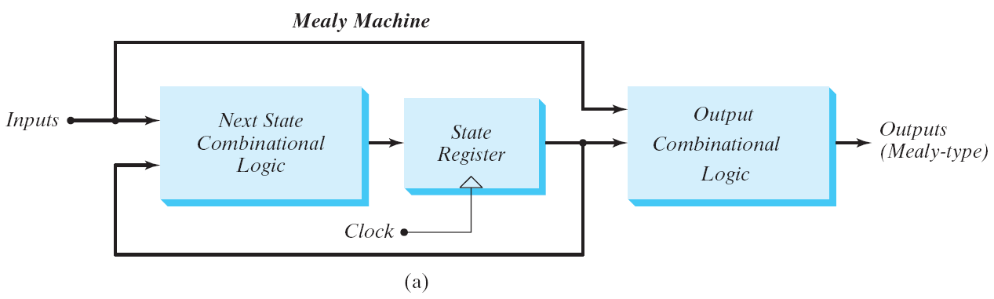
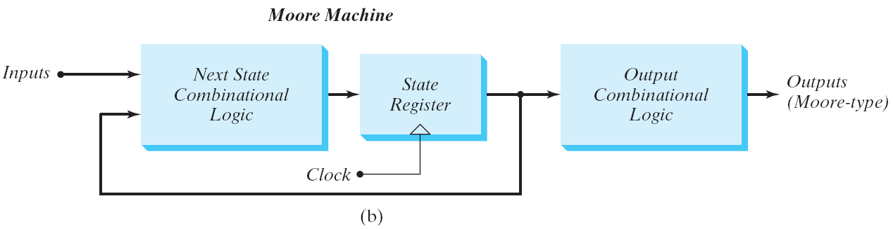
Mealy and Moore Models
Fig. 5.21 Block diagram of Mealy and Moore state machine

Slide 40
Mealy and Moore Models
Mealy
Moore
Present State |  | I/P | Next State |  | O/P
A | B | x | A | B | y
0 | 0 | 0 | 0 | 0 | 0
0 | 0 | 1 | 0 | 1 | 0
0 | 1 | 0 | 0 | 0 | 1
0 | 1 | 1 | 1 | 1 | 0
1 | 0 | 0 | 0 | 0 | 1
1 | 0 | 1 | 1 | 0 | 0
1 | 1 | 0 | 0 | 0 | 1
1 | 1 | 1 | 1 | 0 | 0
Present State |  | I/P | Next State |  | O/P
A | B | x | A | B | y
0 | 0 | 0 | 0 | 0 | 0
0 | 0 | 1 | 0 | 1 | 0
0 | 1 | 0 | 0 | 1 | 0
0 | 1 | 1 | 1 | 0 | 0
1 | 0 | 0 | 1 | 0 | 0
1 | 0 | 1 | 1 | 1 | 0
1 | 1 | 0 | 1 | 1 | 1
1 | 1 | 1 | 0 | 0 | 1
For the same state, the output changes with the input
For the same state, the output does not change with the input

Slide 41
Moore State Diagram
State / Output
0
0
1
0 0 / 0
0 1 / 0
1
1
1 1 / 1
1 0 / 0
1
0
0

Slide 42
Design Procedure
Design Procedure for sequential circuit
The word description of the circuit behavior to get a state diagram;
State reduction if necessary;
Assign binary values to the states;
Obtain the binary-coded state table;
Choose the type of flip-flops;
Derive the simplified flip-flop input equations and output equations;
Draw the logic diagram;

Slide 43
Design of Clocked Sequential Circuits
Example:
Detect 3 or more consecutive 1’s
0
1
S₀ / 0
S₁ / 0
0
State | A B
S₀ | 0 0
S₁ | 0 1
S₂ | 1 0
S₃ | 1 1
0
1
0
S₃ / 1
S₂ / 0
1
1

Slide 44
Design of Clocked Sequential Circuits
Example:
Detect 3 or more consecutive 1’s
Present State |  | Input | Next State |  | Output
A | B | x | A | B | y
0 | 0 | 0
0 | 0 | 1
0 | 1 | 0
0 | 1 | 1
1 | 0 | 0
1 | 0 | 1
1 | 1 | 0
1 | 1 | 1
0
1
0 0 0
0 1 0
0 0 0
1 0 0
0 0 0
1 1 0
0 0 1
1 1 1
S₀ / 0
S₁ / 0
0
0
1
0
S₃ / 1
S₂ / 0
1
1

Slide 45
Design of Clocked Sequential Circuits
Example:
Detect 3 or more consecutive 1’s
Present State |  | Input | Next State |  | Output
A | B | x | A | B | y
0 | 0 | 0
0 | 0 | 1
0 | 1 | 0
0 | 1 | 1
1 | 0 | 0
1 | 0 | 1
1 | 1 | 0
1 | 1 | 1
Synthesis using D Flip-Flops
0 0 0
0 1 0
0 0 0
1 0 0
0 0 0
1 1 0
0 0 1
1 1 1
A(t+1) = D_{A} (A, B, x)
= ∑ (3, 5, 7)
B(t+1) = D_{B} (A, B, x)
= ∑ (1, 5, 7)
y (A, B, x) = ∑ (6, 7)

Slide 46
Design of Clocked Sequential Circuits with D F.F.
Example:
Detect 3 or more consecutive 1’s
Synthesis using D Flip-Flops
 |  |  |  | B
 |  | 0 | 0 | 1 | 0
A |  | 0 | 1 | 1 | 0
 |  |  | x
D_{A} (A, B, x) = ∑ (3, 5, 7)
= A x + B x
D_{B} (A, B, x) = ∑ (1, 5, 7)
= A x + B’ x
y (A, B, x) = ∑ (6, 7)
= A B
 |  |  |  | B
 |  | 0 | 1 | 0 | 0
A |  | 0 | 1 | 1 | 0
 |  |  | x
 |  |  |  | B
 |  | 0 | 0 | 0 | 0
A |  | 0 | 0 | 1 | 1
 |  |  | x

Slide 47
Design of Clocked Sequential Circuits with D F.F.
Example:
Detect 3 or more consecutive 1’s
Synthesis using D Flip-Flops
D_{A} = A x + B x
D_{B} = A x + B’ x
y = A B

Slide 48
Flip-Flop Excitation Tables
Present State | Next State | F.F. Input
Q(t) | Q(t+1) | D
0 | 0
0 | 1
1 | 0
1 | 1
Present State | Next State | F.F. Input
Q(t) | Q(t+1) | J | K
0 | 0
0 | 1
1 | 0
1 | 1
0 0 (No change)
0 1 (Reset)
0
1
0
1
0 x
1 x
x 1
x 0
1 0 (Set)
1 1 (Toggle)
0 1 (Reset)
1 1 (Toggle)
0 0 (No change)
1 0 (Set)
Q(t) | Q(t+1) | T
0 | 0
0 | 1
1 | 0
1 | 1
0
1
1
0

Slide 49
Design of Clocked Sequential Circuits with JK F.F.
Example:
Detect 3 or more consecutive 1’s
Present State |  | Input | Next State |  | Flip-Flop Inputs
A | B | x | A | B | J_{A} | K_{A} | J_{B} | K_{B}
0 | 0 | 0 | 0 | 0
0 | 0 | 1 | 0 | 1
0 | 1 | 0 | 0 | 0
0 | 1 | 1 | 1 | 0
1 | 0 | 0 | 0 | 0
1 | 0 | 1 | 1 | 1
1 | 1 | 0 | 0 | 0
1 | 1 | 1 | 1 | 1
Synthesis using JK F.F.
0 x
0 x
0 x
1 x
x 1
x 0
x 1
x 0
0 x
1 x
x 1
x 1
0 x
1 x
x 1
x 0
J_{A} (A, B, x) = ∑ (3)
d_{JA} (A, B, x) = ∑ (4,5,6,7)
K_{A} (A, B, x) = ∑ (4, 6)
d_{KA} (A, B, x) = ∑ (0,1,2,3)
J_{B} (A, B, x) = ∑ (1, 5)
d_{JB} (A, B, x) = ∑ (2,3,6,7)
K_{B} (A, B, x) = ∑ (2, 3, 6)
d_{KB} (A, B, x) = ∑ (0,1,4,5)

Slide 50
Design of Clocked Sequential Circuits with JK F.F.
Example:
Detect 3 or more consecutive 1’s
Synthesis using JK Flip-Flops
J_{A} = B x K_{A} = x’
J_{B} = x K_{B} = A’ + x’
 |  |  |  | B
 |  | 0 | 0 | 1 | 0
A |  | x | x | x | x
 |  |  | x
 |  |  |  | B
 |  | x | x | x | x
A |  | 1 | 0 | 0 | 1
 |  |  | x
 |  |  |  | B
 |  | 0 | 1 | x | x
A |  | 0 | 1 | x | x
 |  |  | x
 |  |  |  | B
 |  | x | x | 1 | 1
A |  | x | x | 0 | 1
 |  |  | x

Slide 51
Design of Clocked Sequential Circuits with T F.F.
Example:
Detect 3 or more consecutive 1’s
Present State |  | Input | Next State |  | F.F. Input
A | B | x | A | B | T_{A} T_{B}
0 | 0 | 0 | 0 | 0
0 | 0 | 1 | 0 | 1
0 | 1 | 0 | 0 | 0
0 | 1 | 1 | 1 | 0
1 | 0 | 0 | 0 | 0
1 | 0 | 1 | 1 | 1
1 | 1 | 0 | 0 | 0
1 | 1 | 1 | 1 | 1
Synthesis using T Flip-Flops
0
0
0
1
1
0
1
0
0
1
1
1
0
1
1
0
T_{A} (A, B, x) = ∑ (3, 4, 6)
T_{B} (A, B, x) = ∑ (1, 2, 3, 5, 6)

Slide 52
Design of Clocked Sequential Circuits with T F.F.
Example:
Detect 3 or more consecutive 1’s
Synthesis using T Flip-Flops
T_{A} = A x’ + A’ B x
T_{B} = A’ B + B ⊕ x
 |  |  |  | B
 |  | 0 | 0 | 1 | 0
A |  | 1 | 0 | 0 | 1
 |  |  | x
 |  |  |  | B
 |  | 0 | 1 | 1 | 1
A |  | 0 | 1 | 0 | 1
 |  |  | x

Slide 53
Binary Counter Example
Design a 3 bit Binary Counter
Ask yourself :
How many numbers to count : 8 (0 to 2³ -1 )
How many states : 8 (one for each number)
How many states variable : 3
Is there any manual input??
Is there any output??
Does it repeat or stop after 8 ?
Now draw the state diagram and state table

Slide 54
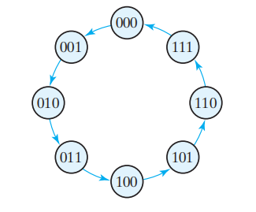

Binary Counter Example

Slide 55
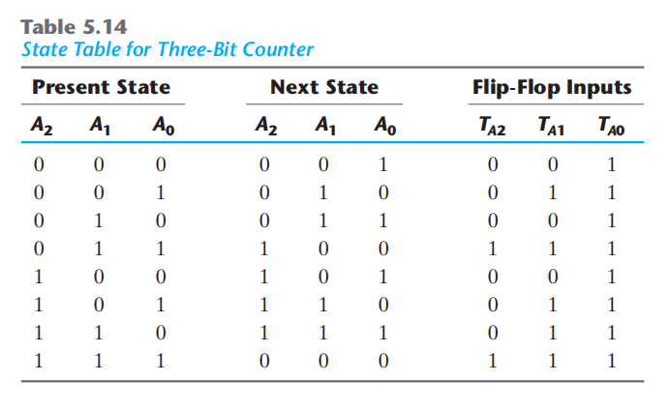
Binary Counter Example

Slide 56
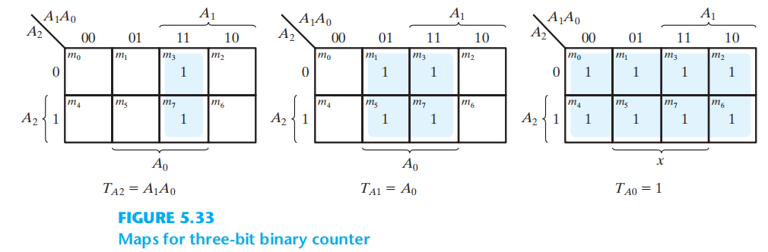
Binary Counter Example

Slide 57
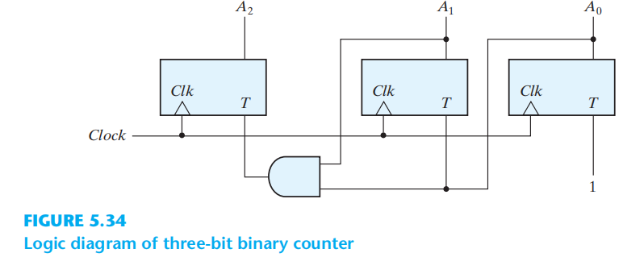
Binary Counter Example

Slide 58
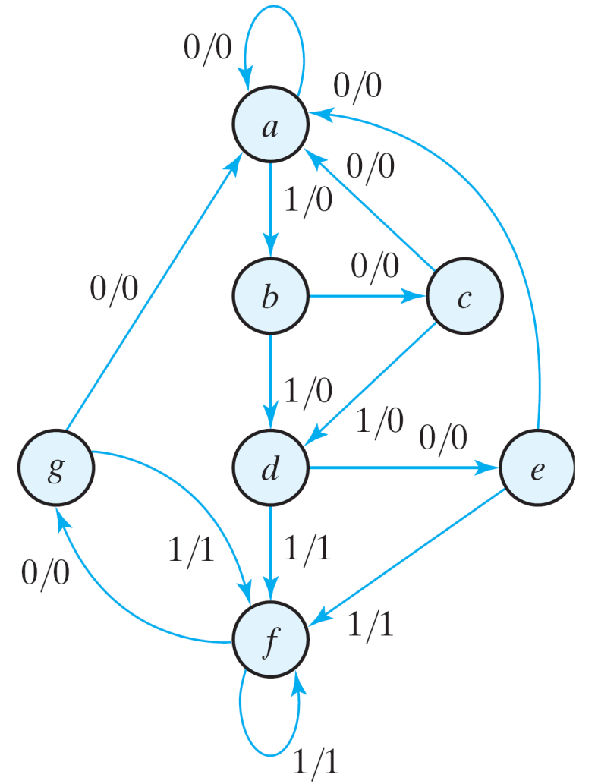
State Reduction and Assignment
State Reduction Reductions on the number of flip-flops and the number of gates.
A reduction in the number of states may result in a reduction in the number of flip-flops.
An example state diagram showing in Fig. 5.25.
Fig. 5.25 State diagram

Slide 59
State Reduction
Only the input-output sequences are important.
Two circuits are equivalent
Have identical outputs for all input sequences;
The number of states is not important.
State: | a | a | b | c | d | e | f | f | g | f | g | a
Input: | 0 | 1 | 0 | 1 | 0 | 1 | 1 | 0 | 1 | 0 | 0
Output: | 0 | 0 | 0 | 0 | 0 | 1 | 1 | 0 | 1 | 0 | 0
Fig. 5.25 State diagram

Slide 60
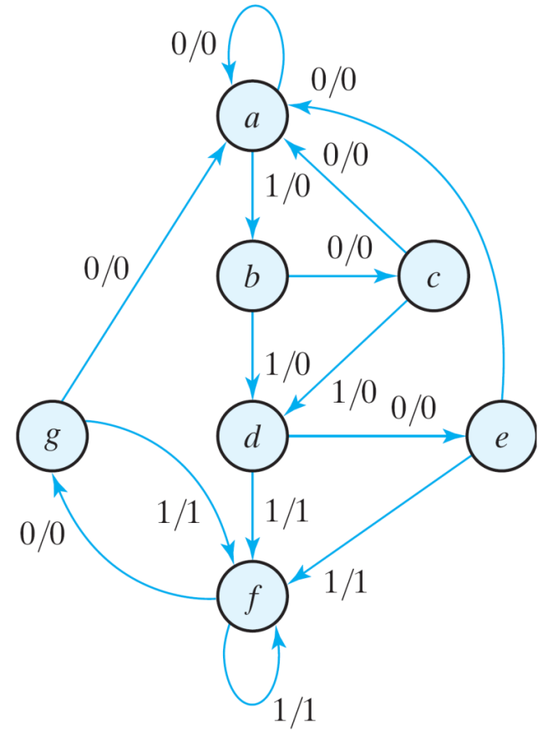
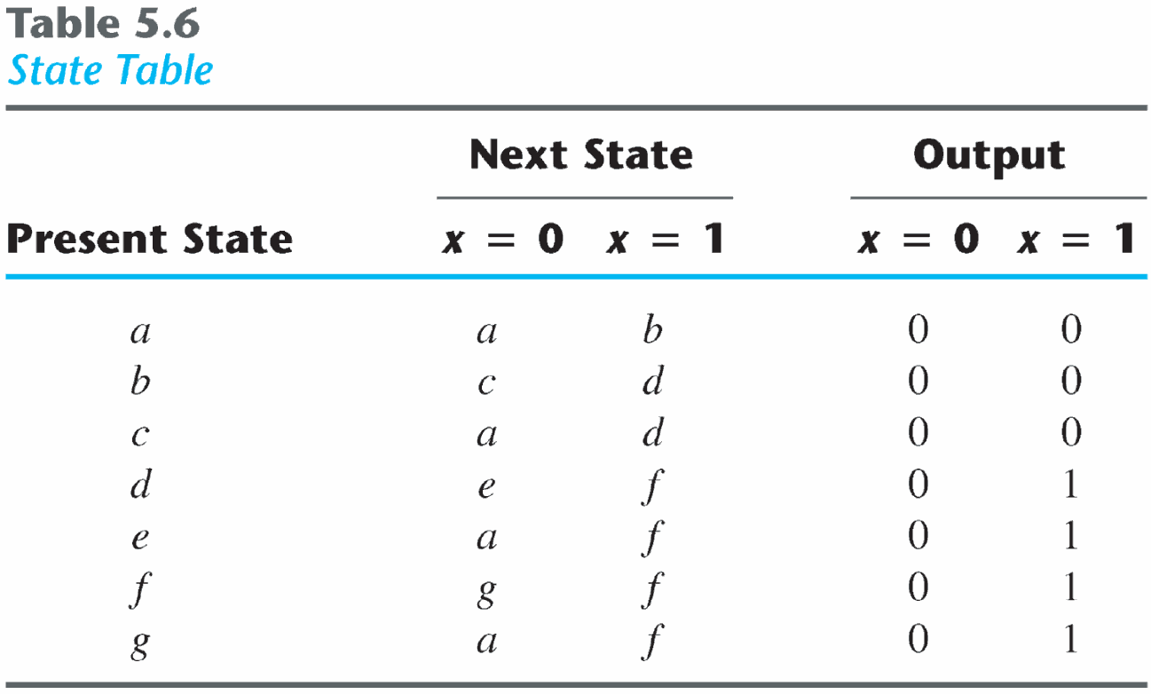
State Reduction
Equivalent states
Two states are said to be equivalent
For each member of the set of inputs, they give exactly the same output and send the circuit to the same state or to an equivalent state.
One of them can be removed.

Slide 61
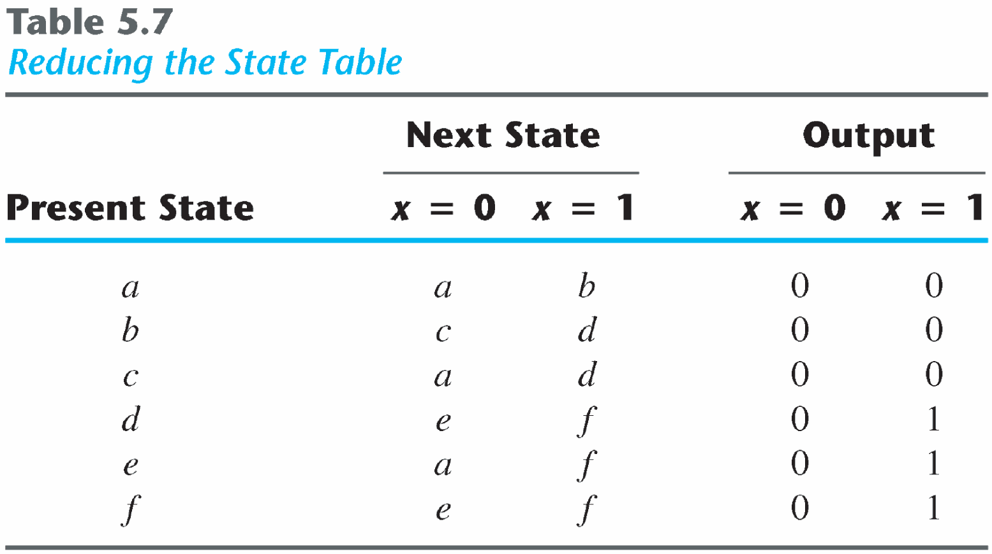
State Reduction
Reducing the state table
e = g (remove g);
d = f (remove f);

Slide 62
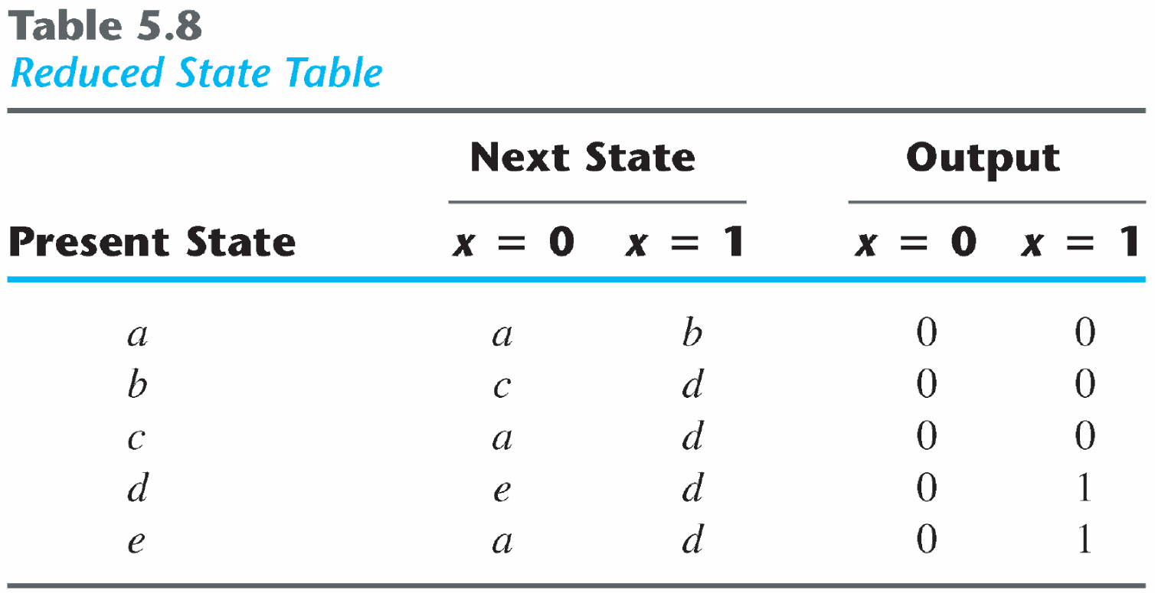
The reduced finite state machine
State: | a | a | b | c | d | e | d | d | e | d | e | a
Input: | 0 | 1 | 0 | 1 | 0 | 1 | 1 | 0 | 1 | 0 | 0
Output: | 0 | 0 | 0 | 0 | 0 | 1 | 1 | 0 | 1 | 0 | 0

Slide 63
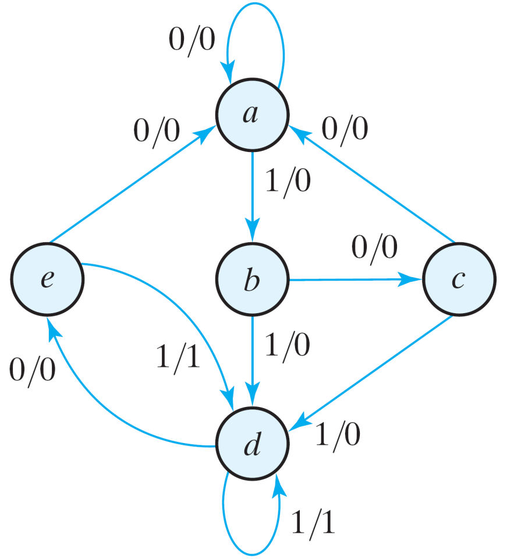
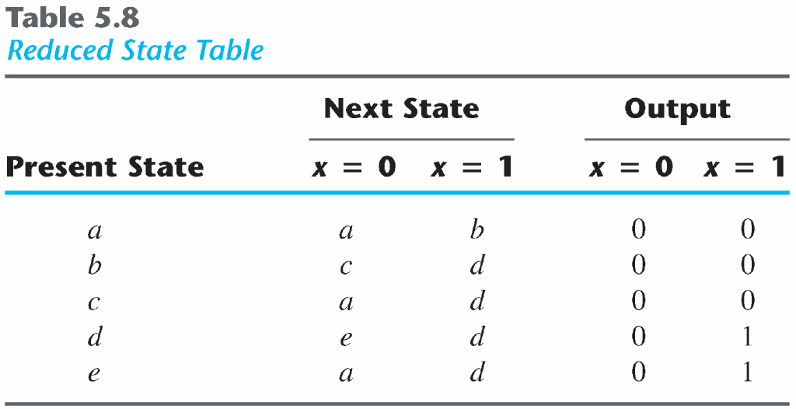
Reduced State diagram
The checking of each pair of states for possible equivalence can be done systematically using Implication Table.
The unused states are treated as don't-care condition ⇒ fewer combinational gates.
Fig. 5.26 Reduced State diagram

Slide 64
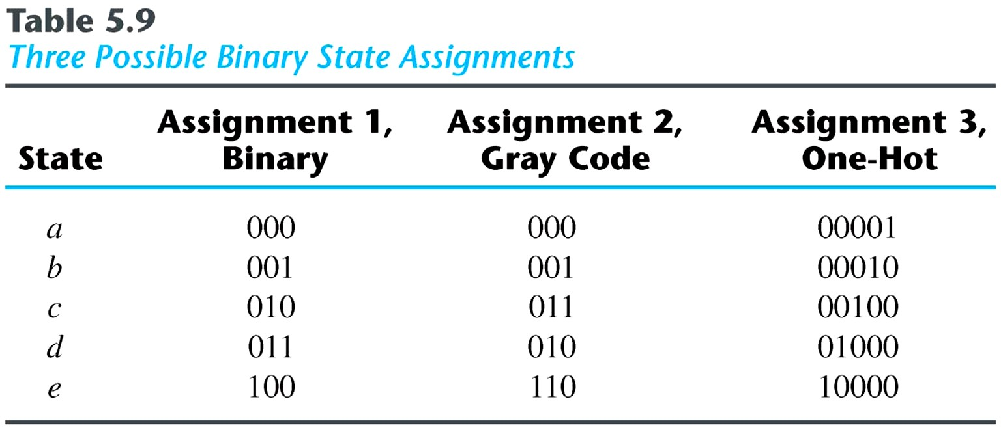
State Assignment
★ State Assignment
★ To
●
minimize the cost of the combinational circuits.
Three possible binary
state
assignments.
(m
states
need
n-bits,
where
2^{n}
>
m)

Slide 65
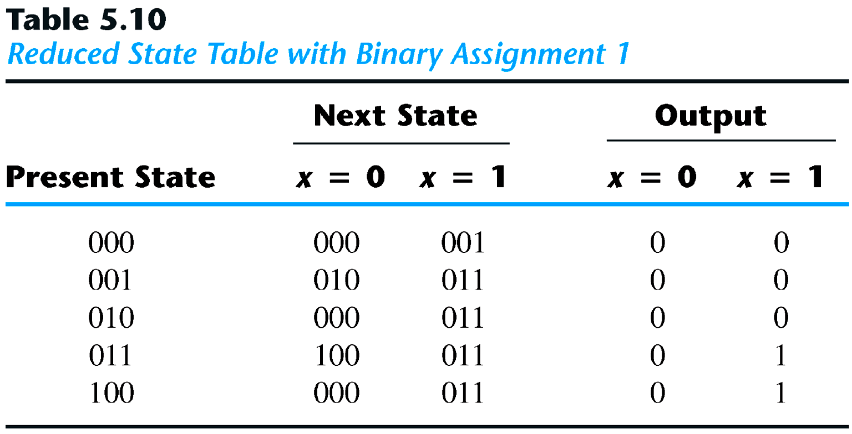
State Assignment
●
Any binary number assignment is satisfactory
as
long
as each state is assigned a
unique
number.
●
Use
binary
assignment
1.

Slide 66
Thanks To
Mustafa Kemal Uyguroğlu

